Slide 1




SMART INDIA HACKATHON 2025
Problem Statement ID : SIH25009
Problem Statement Title : Gamified Environmental Education Platform For Schools And Colleges
Theme : Smart Education
PS Category : Software
Team Name : Tech Legend
1

Slide 2



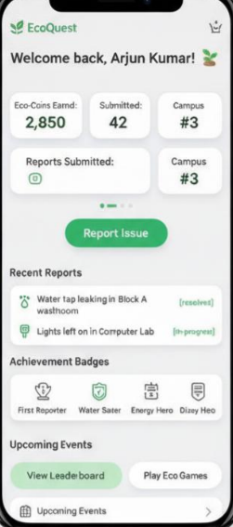







Tech Legend
Bridging the Gap Between Knowing and Doing
The Problem :
The Solution :
An app that Teaches Eco-Friendly
Habits through Fun Games and
Real-World Tasks.
Education is Theoretical, Not Practical.
No Path for Local, Real-World Action.
Students earn points and compete
in school-level challenges for rewards.
Fails to Engage Students or Build Habits.

Slide 3

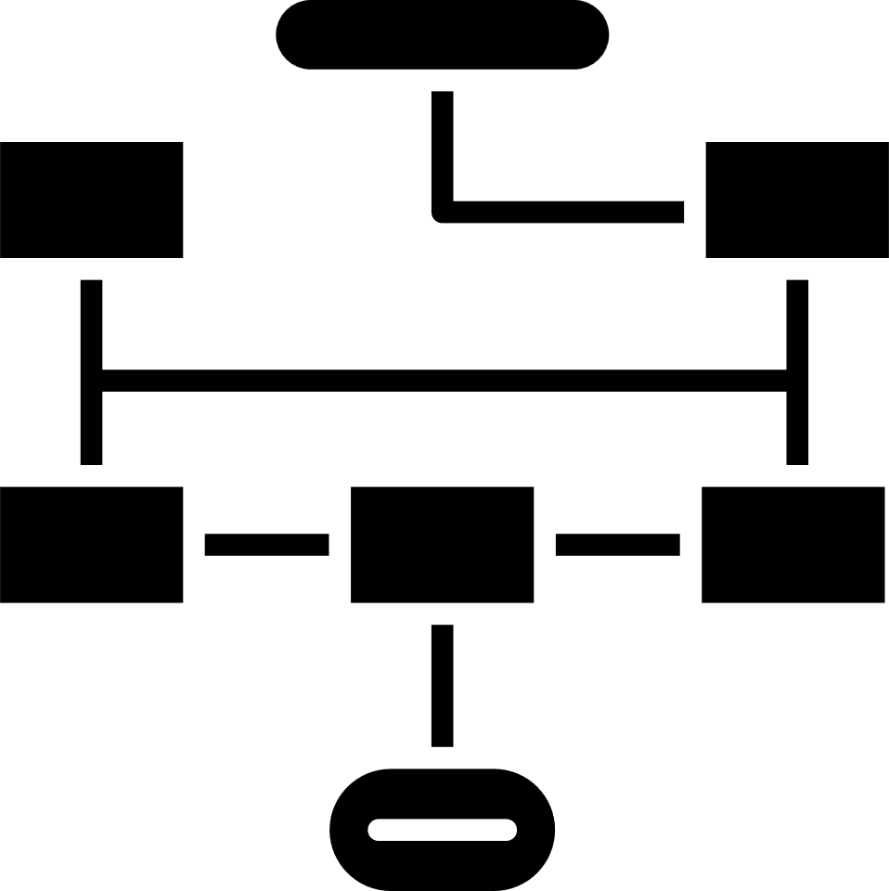
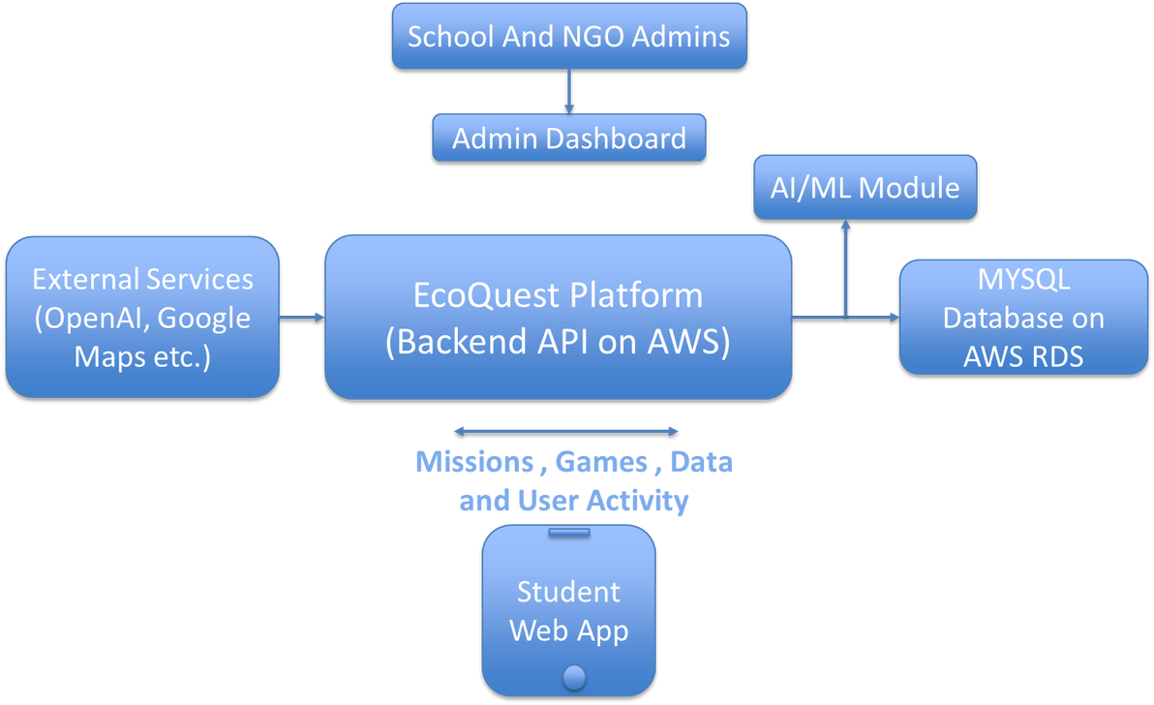












Tech Legend
Built on a Modern & Scalable Architecture
Our Technology Stack
High-Level Architecture
Frontend :
React JS
Backend :
Deployment :
AI and API :

Slide 4
Tech Legend
Built on a Modern & Scalable Architecture
School And Admins
Admin Dashboard
The EcoQuest Web App
Impact And Recognition
Student User
Engage with Missions & NGO Drives
Report Campus Alert
Learn through animated videos and games
View Dashboard & Profile
Earns Eco-Coins & Badges
Climbs the “Wall Of Fame”
Builds a ‘Green’ Profile
MySQL Database
Node js Backend
External APIS & AI

Slide 5
Tech Legend
A Clear Plan for Execution, Success, and Growth
Feasibility
Viability
Scalability
(Can we build it?)
(Will it Succeed?)
(How will it grow?)
Scalable Tech Stack
Critical National Need
Pilot Program to State Rollout
Rapid Development
High User Adoption
AI-Powered Personalization
Easy Integration
Diverse Revenue System
Integration with NGO Portals
Secure And Private
Data Driven Growth
Creating a Campus Alert System

Slide 6









Tech Legend
Creating Measurable Impact and National Benefits
Impacts :
Benefits :
70% increased
Engagement
Supports National Education Policy
Actionable Campus Insights
Advances Mission Life
Verifiable Student Skills
Builds Future Green Leaders
Verified Real-World Action
Fosters a "Green" Mindset

Slide 7

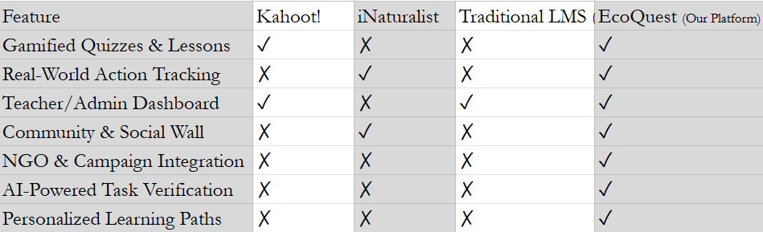

Tech Legend
Our Competitive Advantage
Research :
References :
Gee, J. P. (2003). What Video Games Have to Teach Us About Learning and Literacy. Palgrave Macmillan.
Ministry of Education, Government of India – Environmental Education initiatives. https://www.education.gov.in/
GeeksforGeeks: Articles on Gamification in Education – https://www.geeksforgeeks.org/
Edutopia: Gamification in Classrooms – https://www.edutopia.org/
Dev.to & Medium blogs on gamification strategies.

